Slide 1
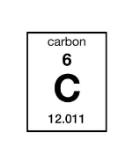
Make a model of the element Carbon
Protons =
Neutrons =
Electrons =
Electron Configuration

