Slide 1
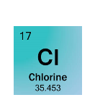
Make a model of the element Chlorine
Protons =
Neutrons =
Electrons =
Electron Configuration

